Slide 1
Welcome to our Parent Reading Workshop
Our aims for today –
Look at what the research says about reading and its importance
Understand the importance of early reading and phonics
Understand the importance of fluency and how you can build this at home
Have a clear understanding of comprehension
Give hints and tips of how to get your child reading at home
Notes:
Laura

Slide 2
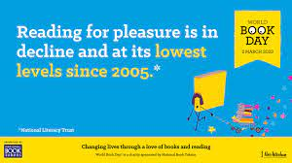
The survey of 71,400 children and young people by the National Literacy Trust early in 2023 has revealed that fewer than one in three children (28%) aged eight to 18 read daily for enjoyment.
Notes:
Laura

Slide 3
Why is there a decline in reading for pleasure?
Games and online distractions
Rise in social media
Find books boring
Lack of time
Not being read to from an early age by adults (at home and school)
Seeing reading as a process for learning rather a pleasure activity
Notes:
Laura
Lack of time – parents are busy trying to work and also children are busy with clubs outside of school.
Not being read to – again, often no one’s fault, just difficult to find the time. Sometimes, late to bed, not time or everyone is too tired.

Slide 4
Benefits of reading for pleasure
Reading helps children learn about the world around them and develop an appreciation for others’ experiences. Builds respect, empathy and compassion for others.
Reading connects learners with the world around them. When a child reads a book, they are not only learning how to read the words, but they are also exploring concepts and ideas. This builds their wisdom.
Reading for pleasure sparks their imagination and helps them learn to love learning. Children become curious after reading.
Reading develops essential literacy skills which improves reading and writing attainment now and in the future.
Reading improves their vocabulary understanding. This is useful for understanding the world as they grow up e.g. watching documentaries, listening to the news, understanding exam papers.
Reading allows time to de-stress and get away from any issues or worries. Takes children to another world.
Notes:
Laura
1 – appreciate other people who may be different to them or be living different situations, including other cultures. It builds the respect between people.
3 Imagination is important for their play and also their creativity.
4 – children who read more are known to do better in tests at the end of KS2 and beyond.
5 – we call these words tier 2 – they have those tricky ones which may have more than meaning or just difficult to use. These words are important for their future selves when working in new environments.

Slide 5

Michael Rosen

Slide 6
Impact of reading
Amount of reading per day | 20 mins | 5 mins | 1 min
Number of minutes per year | 3600 | 900 | 180
Number of words per year | 1.8 Million | 282,000 | 8000
Hours read by the end of primary school | 851 | 212 | 42
Notes:
Laura
Can see the impact of reading each day has.
Reading for 20 minutes per days means they will more likely score better in tests – in the 90th percentile.

Slide 7
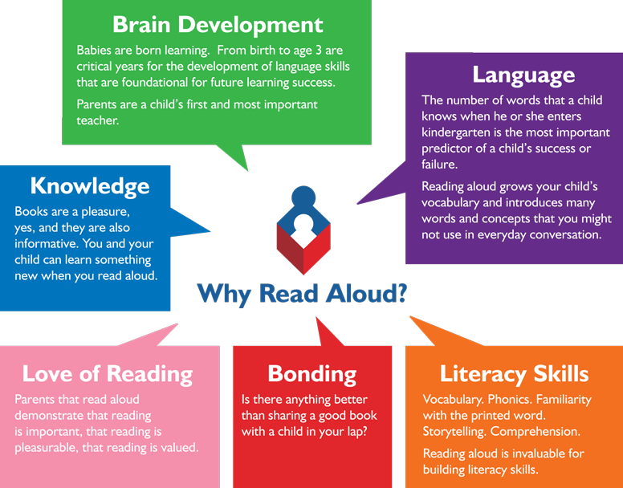
Reading and sharing books from an early age
Notes:
Laura Together with Blundeston pre-school, we encourage sharing books from an early age – see this handout.
Bonding is an important part of sharing a book. We do lots of work on children’s personal development and mental health. This bonding time allows children to feel safe and calm. These times are essential as trust is built and those little conversations start to emerge e.g. a problem or worry they might have.

Slide 8
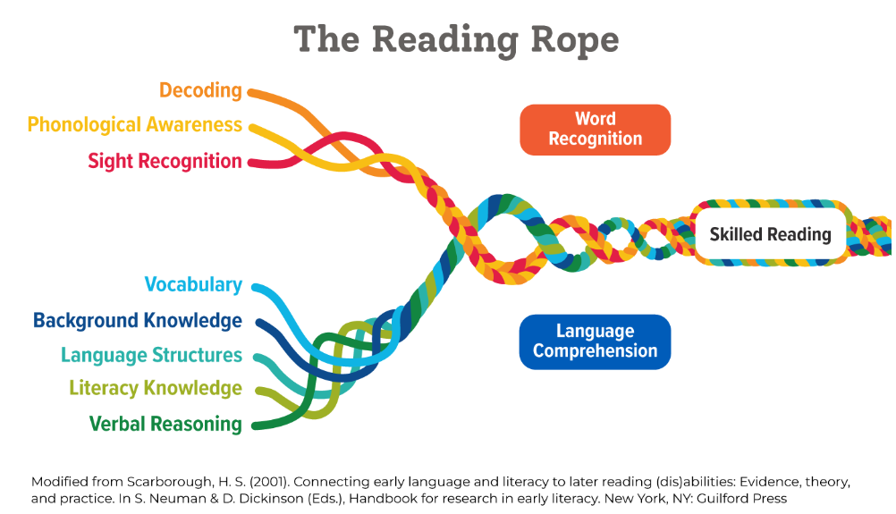
Notes:
Laura Reading rope was designed by a scientist at the university of Scarborough – known as the scarborough reading rope. This shows how complex reading is. There is the word recognition and the language comprehension that combine to make a skilled reader.
We are going to talk you through some of the aspects of these skills.

Slide 9
Word recognition
Learning in EYFS & KS1
Includes work on phonics, syllables and rhyming.
Some children in KS2 will still be working on these elements of word recognition. Interventions take place to support these children.
Must practise at home.
Notes:
Laura Reading rope was designed by a scientist at the university of Scarborough – known as the scarborough reading rope. This shows how complex reading is. There is the word recognition and the language comprehension that combine to make a skilled reader.

Slide 10
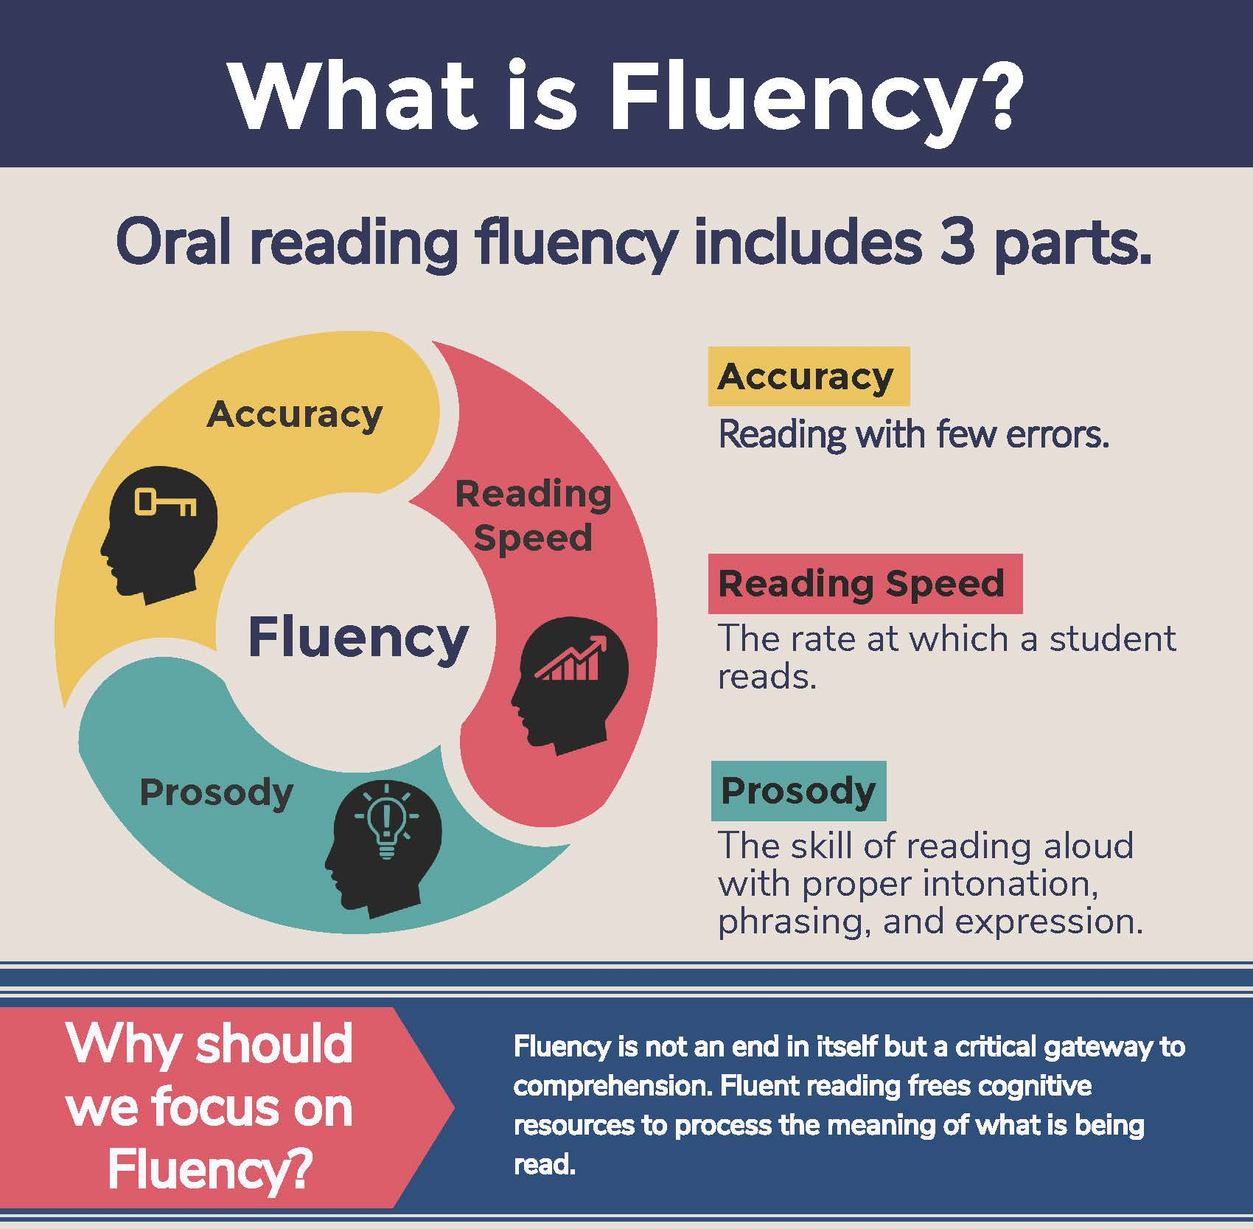
What is fluency and why is it important?
Fluent reading supports reading comprehension. When pupils read fluently, their cognitive resources can be redirected from focusing on decoding and onto comprehending the text.
Basically, if the brain’s processing power isn’t being used up by working out how to read a word, it can concentrate on understanding and enjoying the text.
Notes:
Sam
Once children have good word recognition, they can work on the fluency. This is often difficult skill for children. Once they become more fluent – without decoding or pausing – they can begin to focus on the comprehension skills.
All children, even in upper KS2, should be practising fluency at home in school.
In school, we use WCR. Teachers model fluency by reading the passage to the children. Children will practise reading a small section, taking note of punctuation and intonation.

Slide 11
Three ways you can help build fluency at home…
Read and follow – the adult reads the text and the child follows along with their finger. This helps the child with word recognition and models how to read with fluency. Make sure you pause for punctuation!
My turn, your turn – take turns reading a page, paragraph or sentence. Here you are modelling how to read with fluency, flow and expression. It offers a model for any tricky words.
Echo Reading – as you read, the child copies. It is important here to pace yourself and read at a rate that your child can keep up with.
Notes:
Sam

Slide 12
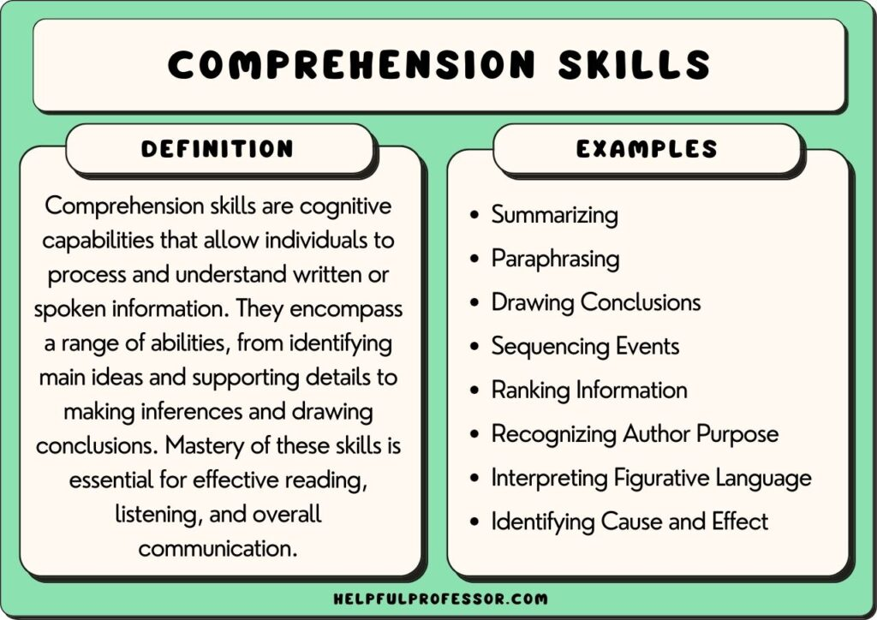
Language comprehension
This refers to the understanding of a text.
There are cases of where children are able to read thanks to secure phonics knowledge, but do not understand what they have read.
Notes:
Kate

Slide 13
How do we teach comprehension in school?
Vocabulary
Inference
Prediction
Explanation
Retrieval
Summarise
Notes:
Kate We use whole class reading in school. Some children in upper KS2 will read on their own. Using the text, we ask questions based on these VIPERS. We allow children to discuss and share ideas.
Let’s look in more detail

Slide 14
Vocabulary:
Interpreting words in context and deciphering the meaning of unknown words unknown based on the context they are written.
Mr Ali loathes wearing a tie as he finds it uncomfortable.
We may not know the meaning of the word ‘loathe’ here but based on the context and other evidence within the sentence, we can guess it means ‘doesn’t like’.
Beowulf was incensed by Grendel’s attack and vowed revenge.
We may not know the meaning of the word ‘incensed’ here but we can guess it means ‘angered’.
Notes:
Kate

Slide 15
Inference:
Reading between the lines. Using evidence within the text as well as background knowledge.
The police find a threatening letter addressed to the victim.
We could infer that someone didn’t like that person.
My stomach rumbled as the smell of dinner wafted from the kitchen.
We could infer that this person is hungry.
Notes:
Kate

Slide 16
Predict:
What has or what will happen based on information stated or inferred (linked closely to inference). Again, background knowledge is important.
Beowulf snatched his sword from the armoury and ran towards the mountains.
  What do predict Beowulf is going to do? What evidence have you used to make your prediction?
Mr Ali woke up with a terrible headache and severe cough. He picked up his mobile and began to dial.
  Who do you think Mr Ali is going to call? Why?
Predictions, like inferences are neither right or wrong, they may be strong (with secure evidence to back them up) or weak (with little or poor evidence to back them up).
Notes:
Sam

Slide 17
Explain:
Children are encouraged to explain their preferences, thoughts and opinions about a text. As they get more confident, children should also be able to explain themes and patterns across a text as well as why authors have made certain choices and the impact of these on the overall effect of the writing.
Who is your favourite character? Why?
Would you like to live in this setting? Why / why not?
Is there anything you would change about this story?
How does the author build up the tension here?
Why do you think the author doesn’t name the villain yet?
Why has the text been arranged in this way?
Notes:
Sam Often tricky as the children have to give reasons for their answers.

Slide 18
Retrieve:
Retrieval of information is often the starting point for discussing a text. This means picking the exact information out of the text that they have just read.
What was the character’s name?
What did they eat for dinner?
What colour was the car?
What time did…
Summary:
Summarise main ideas from more than one paragraph
  What is the main point of the first paragraph?
  What heading would be appropriate for this paragraph?
Notes:
Sam

Slide 19
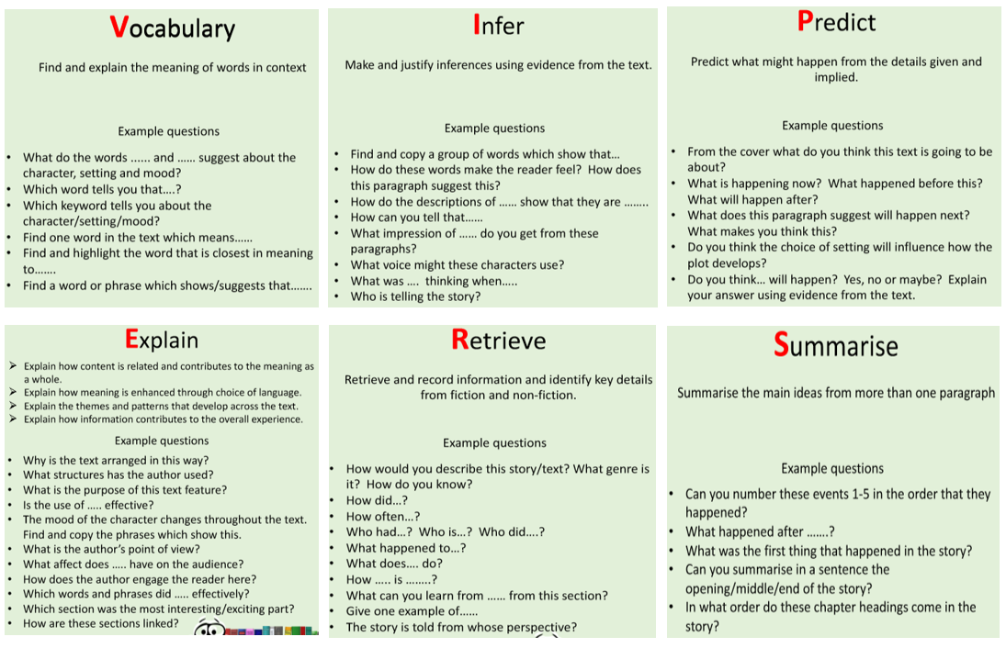
Questions you can ask at home…see handout
Notes:
Laura This is just guidance! Please don’t think you have to ask these. Some children may not respond well to ‘lesson questions’ but it is always good to model e.g. I think x may happen next because…
I think this character has changed because…

Slide 20
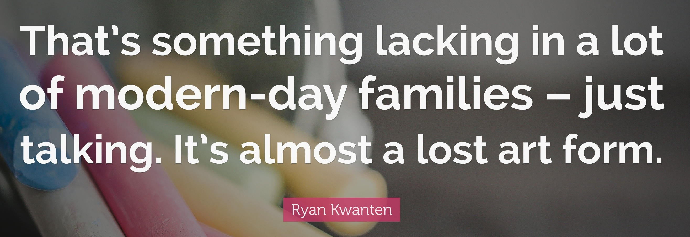
What you can do to help develop comprehension…
Comprehension of the world will develop comprehension in reading…
  Talk a lot at home… about everything
  Model to the children - ask questions “I wonder…” and comment on everything
  Develop cultural capital (knowledge of the world) by going out and about
Notes:
Laura Lots of these VIPERS are using knowledge of the world around them. There are ways to promote comprehension – basically talking and commenting on everything! How the day was, the weather, what’s happened that day.
Some children find this hard so modelling to them is useful. I wonder why it’s so slippery today, I wonder what the weather will be tomorrow. I think you are really happy today because…
Knowledge of the world through experiences – this doesn’t have to be expensive – walks around the local area, camping in the garden, baking together, free museums or art galleries. Try to stimulate their curiosity about the world.

Slide 21
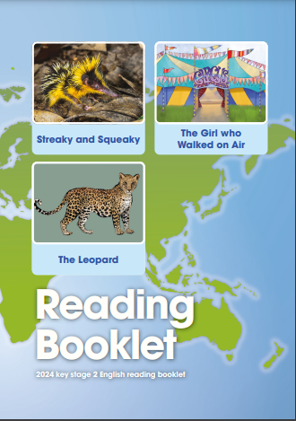

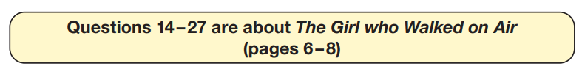

KS2 SATs
60 minutes
/50
27/50 2024
Notes:
Sam
Obviously we have statutory tests the children have to sit.
Being a skilled reader does support the accessibility when they reach the KS2 SATs. The results to do matter to the school BUT we want all children to access and approach these with confidence. Being a skilled reader will help this.
Show example of reading paper and a couple of questions.

Slide 22
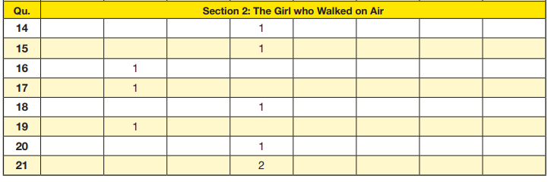
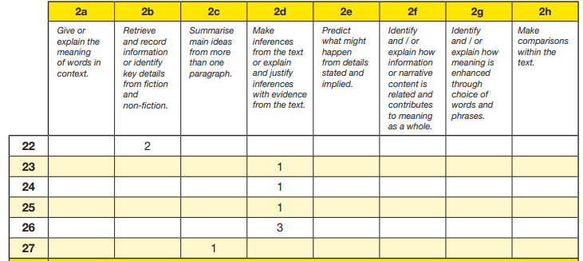
KS2 SATs
Content domains – skills coverage
Example content domains
Give/explain the meaning of words in context
Identify key details from fiction and non-fiction
Make inferences from the text
Explain how meaning is enhanced through choice of words/phrases
Make comparisons within the text
Notes:
Sam

Slide 23
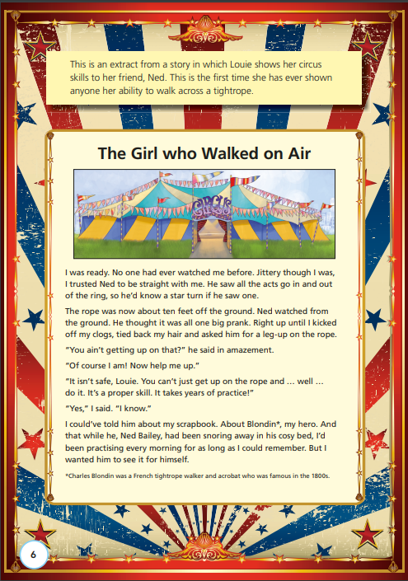
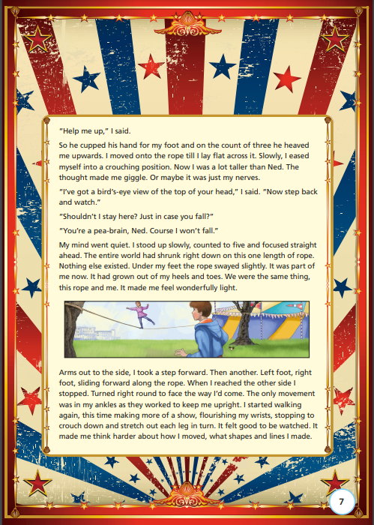
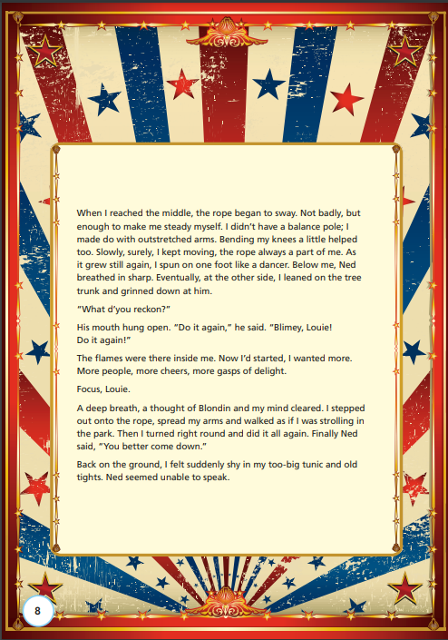
Example- text 2 - The Girl who Walked on Air
One of 3 which needs to be read, understood and analysed (questions answered) within around 20 minutes (60÷3).
Notes:
Sam
Obviously we want the children to reach their potential and be the best readers they can. We do want good results, but we also know that those who can read well, access the tests with less anxiety. We want them to approach the tests with confidence – being a good reader will help this.

Slide 24
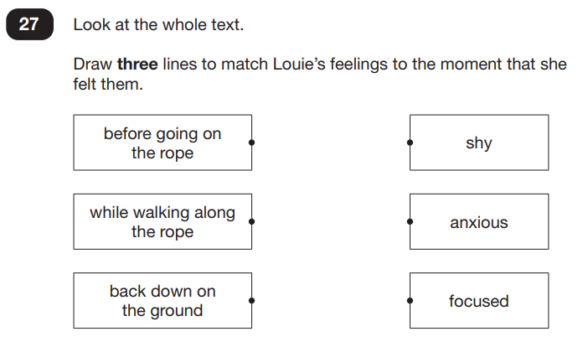
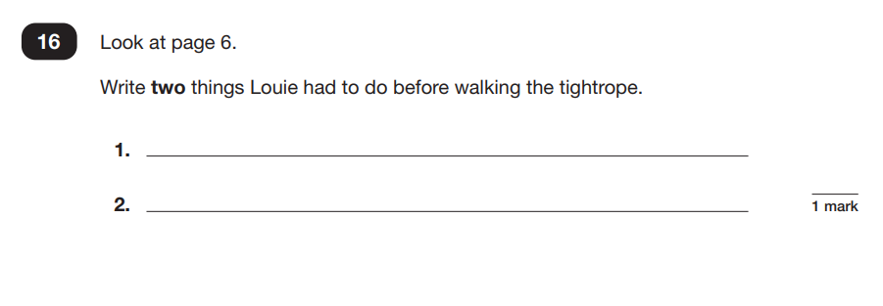

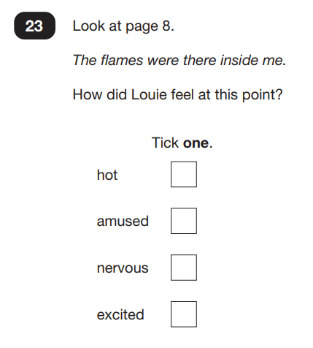
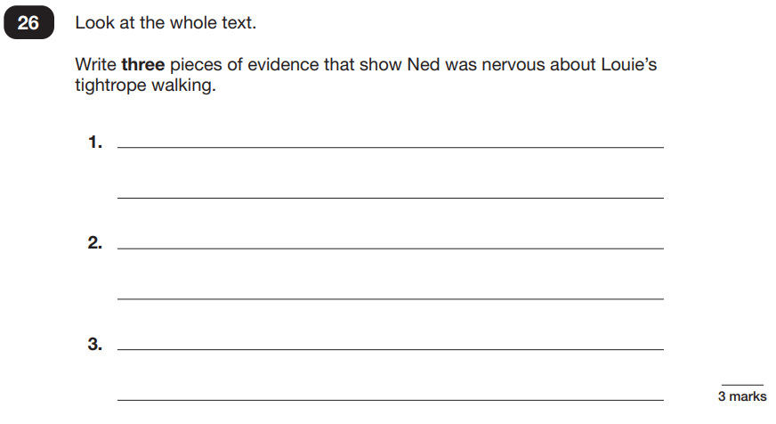
Example questions
Notes:
Sam

Slide 25
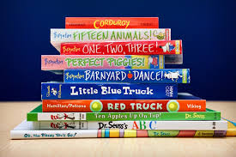
Reading for pleasure & Accelerated Reader
Pros:
* Star reader test, which told the children their ‘ZPD’
* Children knew exactly which books they were allowed
* Comprehension quizzes at the end of every book
* AR taught the children what a book targeted at their level would ‘feel’ like
Cons:
* Some children chose lots of easy books
* Children couldn’t always continue / complete a series of books
* Not enough books at each ZPD level
* Children couldn’t choose books according to their interests
Notes:
Kate

Slide 26
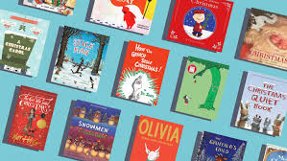
Moving forwards at Blundeston…
We want the children to be able to choose books from the library according to their interests, but this might mean they choose a book which is way above, or below their reading level.
You can still use this book to help your child’s comprehension skills.
You can read the book to your child if it’s too hard for them and then have a conversation about what you’ve read.
You can ask them questions and get them to ask you questions!
Remember, comprehension skills are just as
important as word-reading skills!
Notes:
Kate

Slide 27
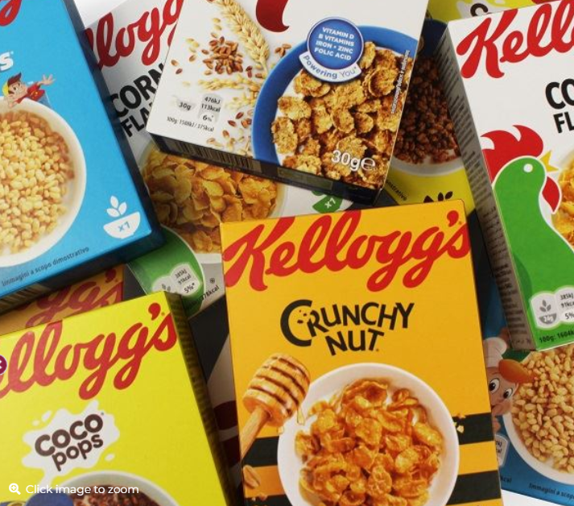
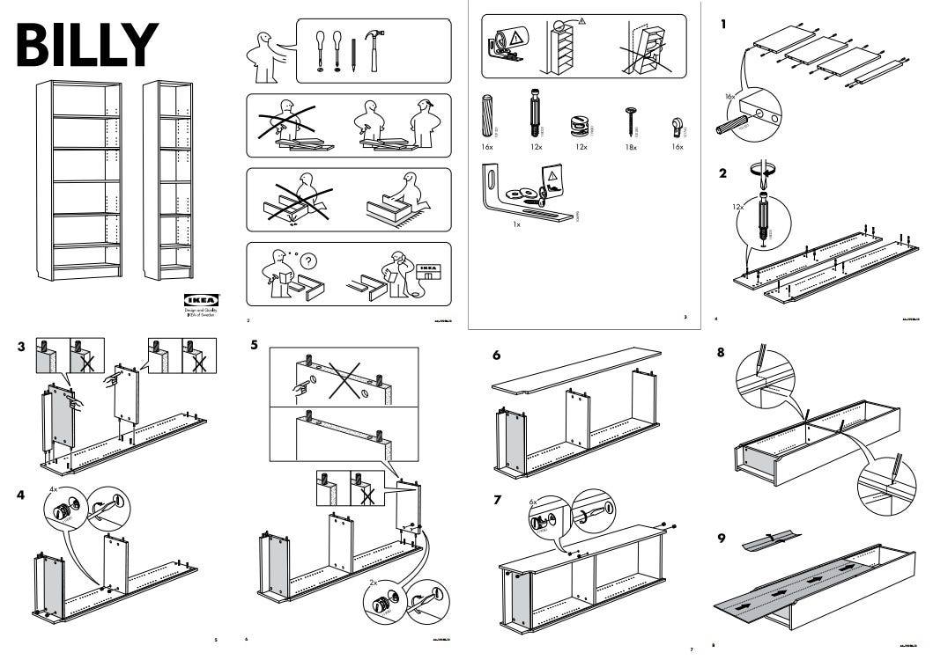
Try to encourage your child to read a wide range of material. Be creative. They don’t even need to have words! Try:
recipes
instructions
magazines
comics
food packets
seed packets
shampoo labels
road signs It all counts!
Notes:
Kate

Slide 28
Moving forwards at Blundeston…
Sometimes, you might want to hear your child read a book that is at the right level for their reading skills.
Talk to them about how to choose a book at the right level.
Show them how to flick through a book, or read a page for practise.
Encourage them to change a book if it’s too hard or too easy, or if they are not enjoying it – all these things are the skills they need to be successful readers.
Notes:
Kate

Slide 29
Other ways reading for pleasure is promoted in school
Libraries in class
Book fairs
Competitions – book shelfie
Authors in school and online – Sue Hendra (Supertato)
WCR – we talk about similar books they might like to read
Author of the month in our library
Reading newsletter each half term
Sharing reading between classes
Notes:
Kate
In school, our job is to teach reading, but ultimately we want the children to WANT to read for LIFE – Lifelong readers and Lifelong reading comes from enjoyment.
What can you do at home - These are a few practical pieces of advice to help develop that love of reading.

Slide 30
How to encourage independent reading at home
Read aloud to children, not just listen to them.
Set a routine for reading.
Having books that the child owns (re-reading books)
Using the library or book swaps with friends to help build variety
Exposing children to texts beyond novel. E.g. comics, magazines, non-fiction books
Taking control of screens – reading first and then screentime
Show that you love reading
Give children books that matter to them
Have a special reading time (bedtime/after dinner) or special place in the house for reading
Notes:
Laura In school, our job is to teach reading, but ultimately we want the children to WANT to read for LIFE – Lifelong readers and Lifelong reading comes from enjoyment.
What can you do at home - These are a few practical pieces of advice to help develop that love of reading.

Slide 31
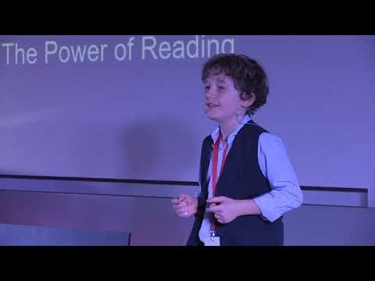
The power of reading from a child…

Slide 32
Any questions?

